Slide 1

Sentiment Analysis
Deep Insight into Customer Feedback with Advanced Analysis
Photo by Robert Linder on Unsplash

Slide 2
Problem Statement
Objective: Efficiently process and classify large volumes of customer reviews to gain actionable insights.
Method: Implement an automated sentiment classification system using machine learning models (Logistic Regression, SVM, Random Forest) and neural network models (CNN, RNN with LSTM).
Process:
Data Wrangling: Load, clean, and transform raw data.
Exploratory Data Analysis: Understand data patterns and trends.
Model Training and Evaluation: Train and evaluate models based on accuracy, AUC score, and loss.
Impact: Provide businesses with actionable insights to quickly respond to customer feedback and improve products and services.

Slide 3
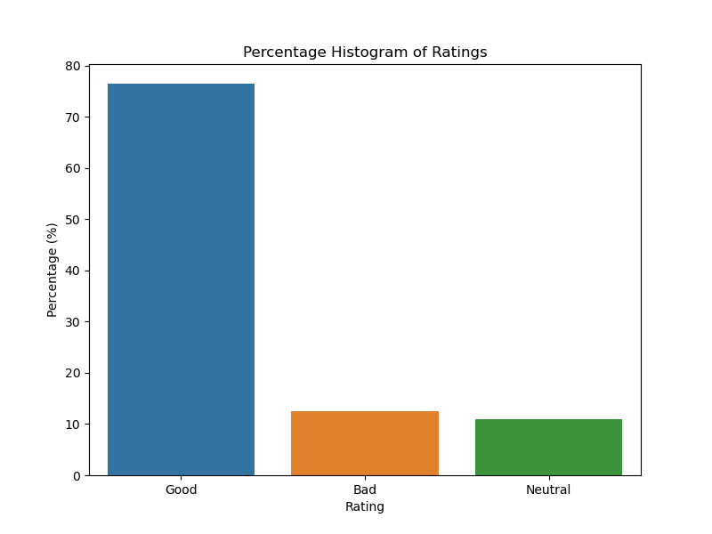
Percentage Histogram of Ratings
High Customer Satisfaction: The majority of reviews fall under the "Good" category, indicating that most customers are pleased with their purchases.
Fewer Neutral and Bad Ratings: The "Neutral" and "Bad" ratings are fewer in comparison, suggesting that fewer customers found the products merely adequate or unsatisfactory.
Overall Positive Sentiment: The distribution is positively skewed, highlighting that the general sentiment towards the products is largely favorable.

Slide 4
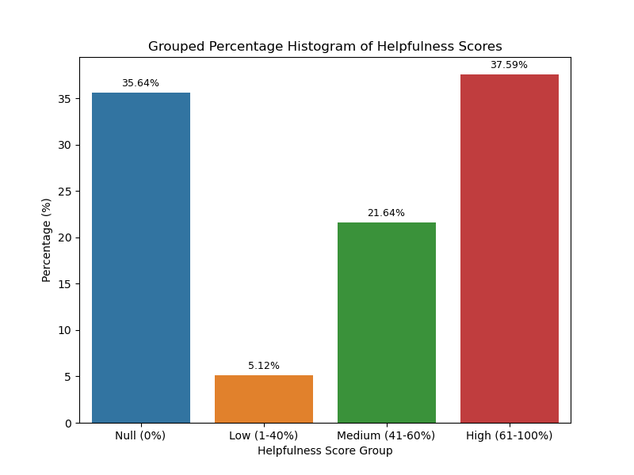
Percentage of Helpfulness Scores
Low Engagement: A significant portion of reviews have a helpfulness score of 0.
Moderate Usefulness: Reviews with low (1-40%) and medium (41-60%) helpfulness scores make up a notable part of the distribution.
High-Quality Reviews: The smallest category, reviews with high helpfulness scores (61-100%), are highly valued for their quality and usefulness, emphasizing the need for creating engaging and high-quality reviews.

Slide 5
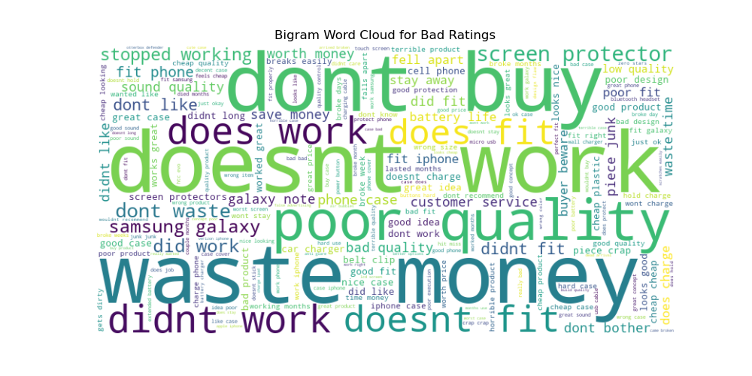
Word Clouds and Text Analysis
Contextual Insights: Analyzing bigrams in review summaries for different rating categories ('Good', 'Neutral', 'Bad') provides deeper insights into customer feedback that single-word analysis might miss.
Nuanced Sentiment: Positive words like "good" and "great" are used in 'Neutral' and 'Bad' reviews, often within complex phrases that convey mixed sentiments, such as "not good" or "works great."
Rating Discrepancies: The analysis reveals discrepancies where the sentiment implied by the text does not always align with the numerical rating, highlighting underlying issues not captured by ratings alone.

Slide 6
Modeling Approach
To classify customer sentiment accurately, we implemented and evaluated various traditional machine learning models and neural network models.
Traditional Machine Learning Models:
Logistic Regression: Utilizes a logistic function to model binary outcomes.
Support Vector Machine (SVM): Finds the optimal hyperplane for classifying data points.
Random Forest: An ensemble method using multiple decision trees to improve classification robustness.
Neural Network Models:
Convolutional Neural Network (CNN): Leverages convolutional layers to capture spatial relationships in text data.
Recurrent Neural Network (RNN) with LSTM: Uses Long Short-Term Memory cells to capture temporal dependencies in sequential data.
Evaluation Metrics: Models are evaluated based on accuracy, AUC score, and loss to determine their effectiveness in sentiment classification.

Slide 7
Model performance
The CNN model demonstrated the highest accuracy and generalization capabilities, making it the preferred choice for sentiment classification
Model | Accuracy | AUC Score | Loss | Strengths | Weaknesses
Logistic Regression | 80.4% | 0.87 | N/A | Simple to implement and interpret, effective for binary classification tasks | May not capture complex patterns as effectively as advanced models
Support Vector Machine (SVM) | 80.4% | 0.87 | N/A | Effective in high-dimensional spaces, robust to overfitting | Computationally intensive, less interpretable than Logistic Regression
Random Forest | 76.63% | 0.8455 | N/A | Handles non-linear relationships well, provides feature importance | Lower accuracy and AUC compared to Logistic Regression and SVM, complexity in interpretation
Convolutional Neural Network (CNN) | 81.81% | N/A | 0.4724 | Superior accuracy and generalization, effective feature extraction through convolutional layers | More computationally intensive, requires more data, less interpretable
Recurrent Neural Network (RNN) with LSTM | 80.13% | N/A | 0.5076 | Captures temporal dependencies, suitable for sequential data | Slightly lower performance compared to CNN, more complex and slower to train

Slide 8
Key Takeaways
Efficiency and Accuracy:
Automates the sentiment analysis process, significantly reducing time and subjectivity.
Achieves high accuracy, with the CNN model demonstrating the best performance at 81.81%.
Actionable Insights:
Provides detailed insights into customer sentiment, enabling businesses to respond quickly to feedback.
Identifies trends and issues that might not be apparent from ratings alone.
Improved Customer Engagement:
Enhances the ability to improve products and services based on detailed sentiment analysis.
Encourages higher-quality and more engaging reviews by highlighting the importance of review helpfulness.
Conclusion: By leveraging automated sentiment analysis, businesses can make more informed decisions, leading to increased customer satisfaction and loyalty.

Slide 9
Future Works
Advanced Models: Explore the use of advanced deep learning models like BERT for improved accuracy and contextual understanding.
Multilingual Support: Expand the system to support multiple languages, enabling sentiment analysis across diverse customer bases.
Aspect-Based Sentiment Analysis: Develop methods to analyze sentiment at a more granular level, focusing on specific aspects of products and services.
Real-Time Analysis: Implement real-time sentiment analysis to provide immediate insights and enable prompt responses to customer feedback..

Slide 10
Thanks for your attention

